Slide 1

Smart HealthCare
Wearable CPS for Stress Detection
Alessia Simone
Supervisor: Prof. Maurizio Palesi
Co-Supervisor: Prof. Sebastiano Battiato

Slide 2
Stress Disorder
Introduction
«Stress is a state of mental or emotional strain or tension resulting from adverse or demanding circumstances»
Oxford Languages
Symptoms
Cardiovascular disease
Increased sweating
Increased core temperature
Decreased peripheral temperature
Increased heart rate
Comorbidity
Anxiety
Fear

Slide 3
What is a CPS?
Cyber
Physical
System
Software part
(data processing, decision-making and algorithms)
Hardware part
(sensors and actuators)
Cyber + Physical interconnection
Major leader of industry 4.0
They are widely used in healthcare domain where integration of wearable devices is helpful.

Slide 4



Research Questions
Objective
Cheap and Quick CPS for stress detection
Does the combination of CPS and Machine Learning produces useful results on stress detection?
What are the potential application?

Slide 5
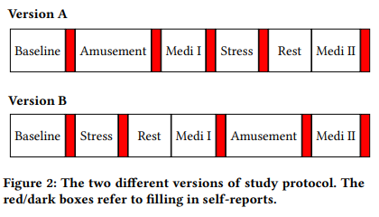
WESAD Dataset
Exploratory Data Analysis
Wearable Stress and Affect Detection:
Subjects: 15 individuals
Devices: Empatica E4 and Respiban
Protocol states: neutral, stress and amusement

Slide 6
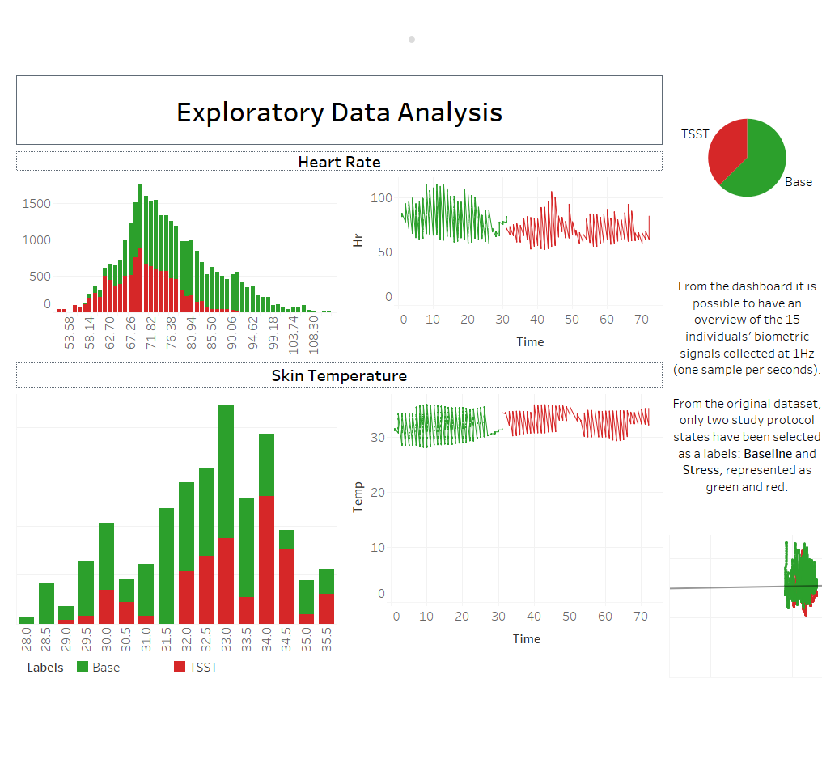

Slide 7
Part 1
Methodology

Slide 8
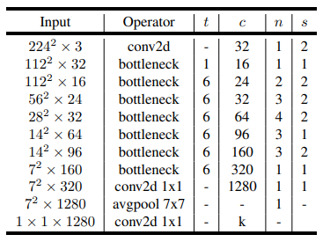
MobileNetV2
Deep
Learning
2M of trainable parameters
146 MB of estimated total size

Slide 9
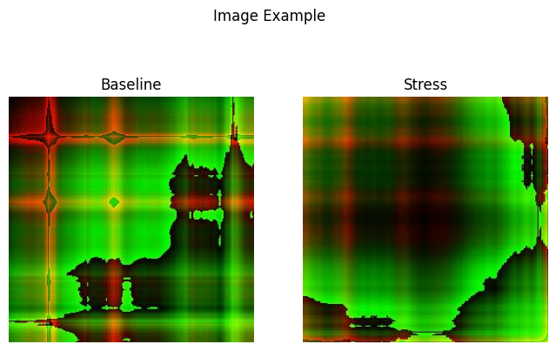
Gramian Angular Field Images

Slide 10
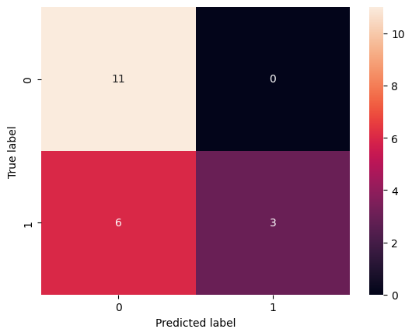
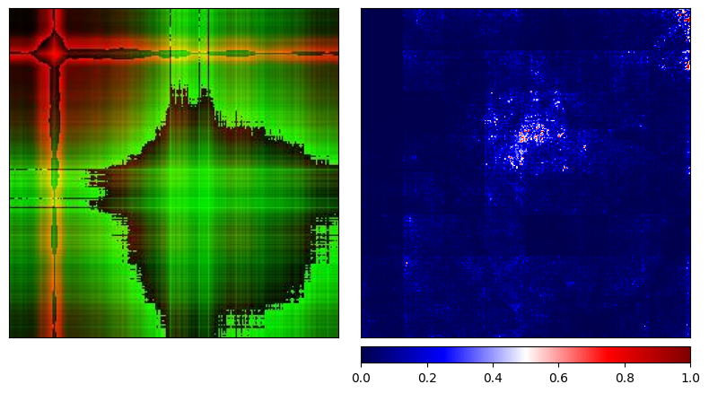
XAI
Noise Tunnel + Guided GradCam
Confusion Matrix
AVG Accuracy: 56%

Slide 11
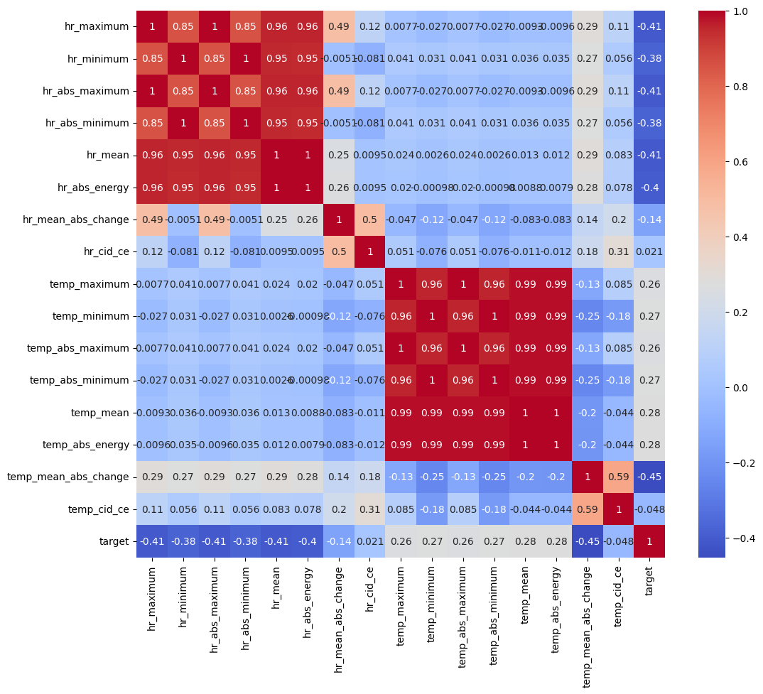
1) Features Extraction
Supervised Machine Learning
minimum
maximum
absolute minimum
absolute maximum
mean
absolute energy
mean absolute change
CID-CE

Slide 12
2) Hyperparameter tuning
Penalty: | Lib-Linear
Solver: | L1
C: | 1
Logistic Regression
Estimators: | 10
Max depth: | 5
Min split: | 10
Random Forest
Booster: | Tree
alpha: | 0.001
eta: | 1
lambda: | 0.001
Leave-One-Subject-Out Cross-Validation
Halving Grid Search
Weighted F1
Extreme Gradient Boosting
Gaussian Naive Bayes
Variance Smoothing: | 2.31e-9

Slide 13
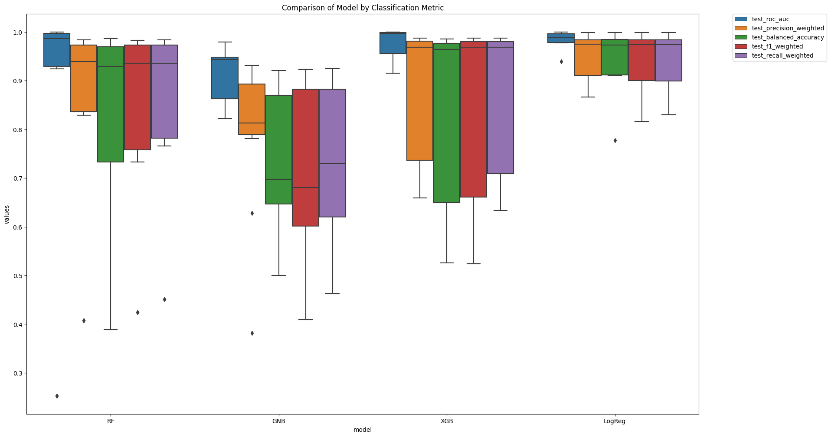
3) Optimal Model
Selection
Model Comparison
1.0
0.9
0.8
0.7
Logistic Regression
AUC of 98% (±0.02),
F1 of 94% (±0.06),
Precision of 95% (±0.05),
Recall of 94% (±0.06),
Accuracy of 94% (±0.07)
0.6
0.5
0.4
0.3
Random
Forest
Gaussian Naïve Bayes
Extreme Gradient Boosting
Logistic
Regression
AUC
Precision
Accuracy
F1
Recall

Slide 14
Part 2
Deployment

Slide 15
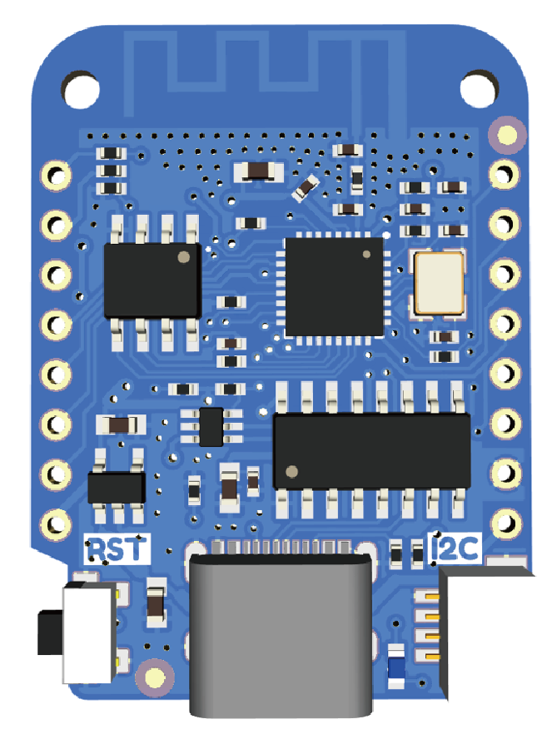
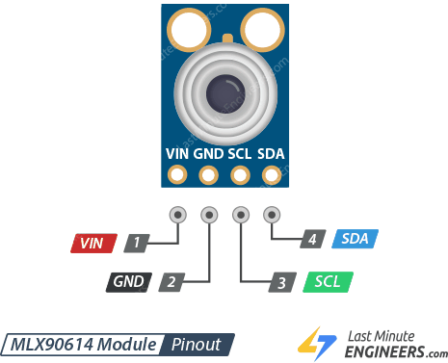
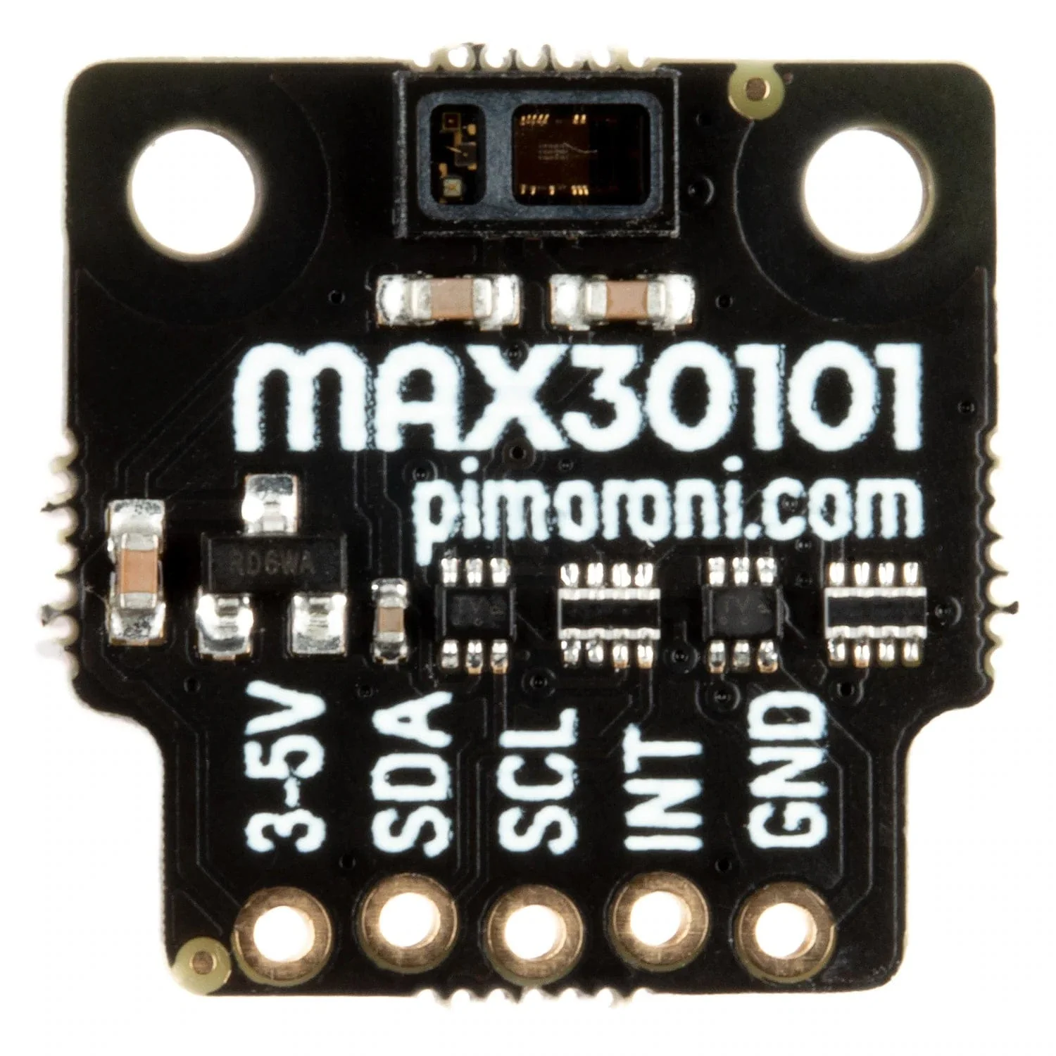
Hardware
Wemos D1 Mini Pro
MLX90614
MAX30101
Operating Voltage | 3.3 / 5 V
GPIO Pins | 11 (1 ADC)
Clock Speed | 80 / 160 MHz
Flash | 16 MB
Size | 34.2 * 25.6mm * 3g
Range | -70°C…+380°C for skin temperature
Resolution | 0.02°C
Accuracy | ±0.2°C within 36-38°C
Output | BVP
LED | IR, Red, Green
ADC Resolution | 18-bit
Internal Algorithm | Motion Artifact Removal, Peripheral Beat Amplitude

Slide 16
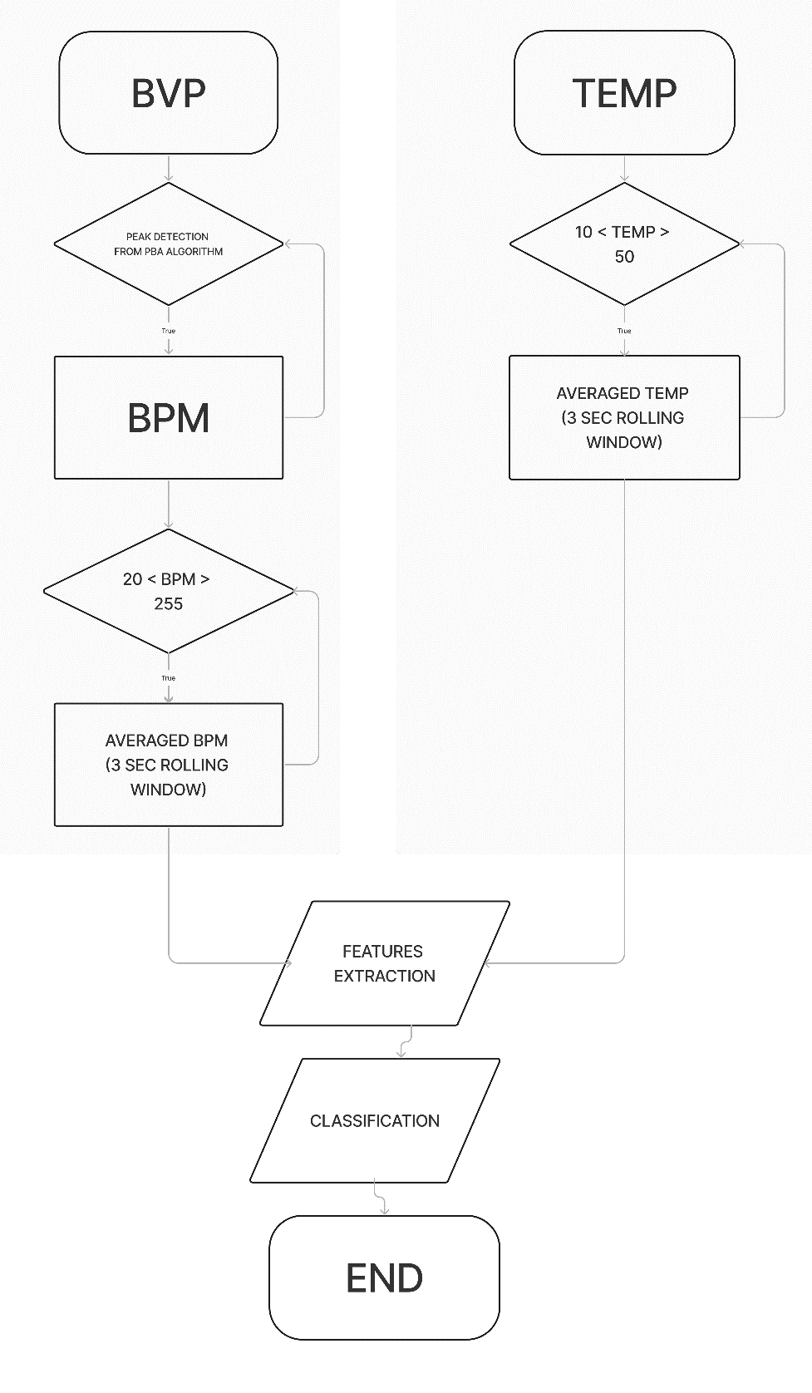
Code Diagram Flow
Software

Slide 17
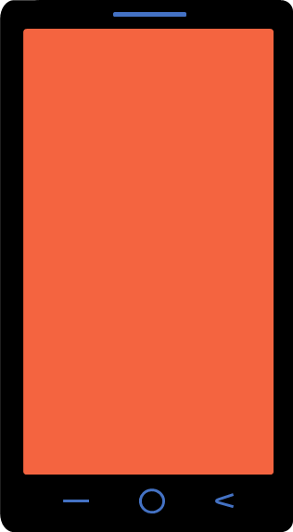
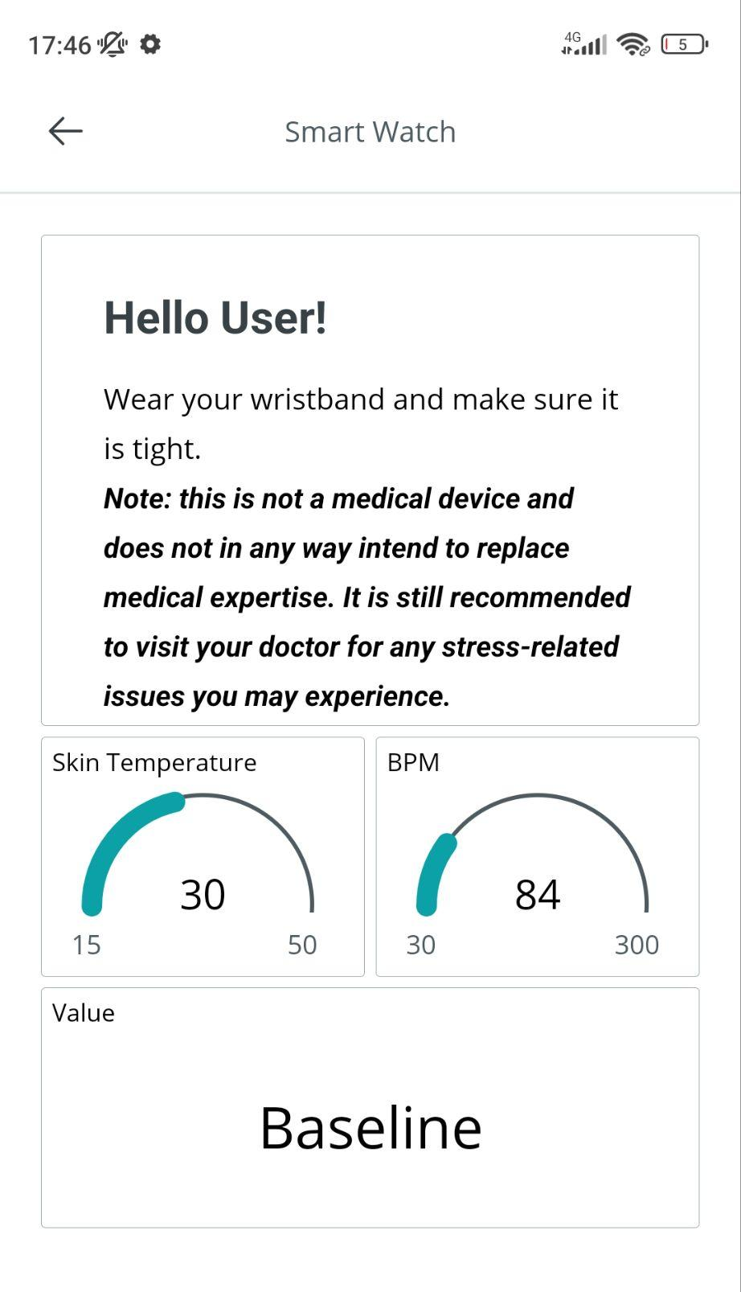

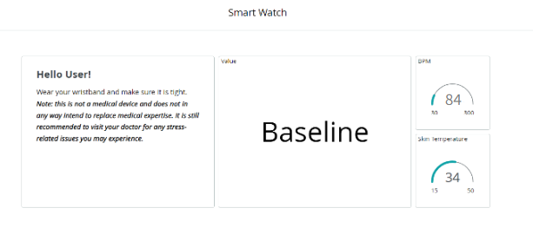

Slide 18
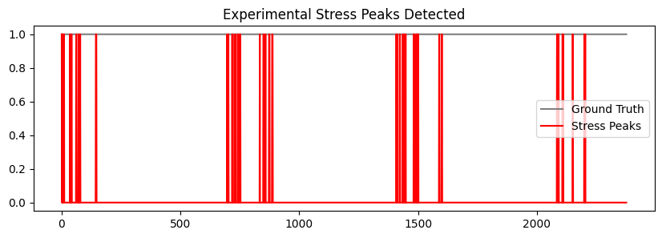
Part 3
Experiment
Experimental procedure:
5% Recall
Stress (5 min) | Baseline (5 min)
Math quiz | Nature sounds

Slide 19


Conclusions
Objective
Cheap: 42 €
Quick: 14 milliseconds for a response
Does the combination of CPS and Machine Learning produces useful results on stress detection?
What are the potential application?
The device is highly useful during cognitive-behavioral oriented psychotherapies, to identify and correct behaviors that cause high levels of stress.
However, the mere support of the device is not sufficient for pathologies that are based on deeper and more complex psychic processes, where anxiety and stress represent surface symptoms.
Dr. Marziano A., psychologist ang psychotherapist, personal communication, 09/07/2023
Features extraction + Logistic Regression
Convolutional Neural Network

Slide 20
Thank you
for your
attention

Slide 21
References
Batista, G. E. a. P. A., Wang, X., & Keogh, E. (2011). A Complexity-Invariant Distance Measure for Time Series. https://doi.org/10.1137/1.9781611972818.60
Cyber physical systems (CPS), cosa sono, come stanno rivoluzionando il mondo industriale | Internet4Things
Figma
Flaticon
In-Depth: Interface MLX90614 IR Temperature Sensor with Arduino
LOLIN D1 mini — WEMOS documentation
Dr. Marziano, A. (2023), psychologist and psychotherapist, personal communication about potential application of Smart Healthcare wearable CPSs.
Oxford Languages and Google - English
Quickly Compare Multiple Models. How to train and evaluate multiple… | by Cole | Towards Data Science
Sandler, M., Howard, A., Zhu, M., Zhmoginov, A., & Chen, L. (2018). MobileNetV2: Inverted Residuals and Linear Bottlenecks. arXiv. https://doi.org/10.1109/cvpr.2018.00474
Schmidt, P., Reiss, A., Duerichen, R., Marbergen, C., & Van Laerhoven, K. (2018). Introducing WESAD, a Multimodal Dataset for Wearable Stress and Affect Detection. ICMI '18: Proceedings of the 20th ACM International Conference on Multimodal Interaction, 400-408. https://doi.org/10.1145/3242969.3242985
Stress

